Slide 1
Azure Immersion Workshop: Infrastructure Migration
Session 5: Introduction to the landing zone concept
Speaker Name

Slide 2
Content
03
05
09
24
31
The value of creating cloud-ready environments
Azure Landing Zones in Cloud Adoption Framework
Azure Landing Zones Design Areas
Enterprise Enrollment
Identity
Resource Management
Governance principles
Azure Blueprints
Azure Policy

Slide 3
Value of cloud-ready environments

Slide 4




The value of creating cloud-ready environments
Aligned to business priorities
Cloud-design considerations
Adapted for cloud operating model
Ready for cloud applications
Adaptable to grow and expand
Compliant
Agile
Cutting-edge innovation
Secure
Notes:
Customer challenges when setting up cloud environments
Architecture complexity
Many customers simply replicate their existing on-premises design and architecture in Azure. However, the mismatch between on-premises infrastructure and cloud-design considerations creates dissonance and friction with respect to defining architectures and standards for their migration to the cloud.
Operating compatibility
Existing approaches and functions for the traditional delivery and management of IT services are not compatible with the Azure platform and cloud operating models. As many customers simply replicate existing on-premises technologies and processes to Azure, customers are struggling to define and therefore transform their operating model to manage and support large-scale cloud infrastructure.
Lack of trust and desire for control
The absence of a precise and detailed cloud architecture that is compliant with their requirements, and the lack of a well-defined operating model to support such a platform, leads IT not to trust Azure and instead strive to maintain full control. This often involves building ‘walls’ and complicated processes which ultimately get in the way of business lines adopting Azure.

Slide 5
Azure Landing Zones in Cloud Adoption Framework

Slide 6
Microsoft Cloud Adoption Framework for Azure
Define strategy
Understand motivations
Business outcomes
Business justification
Prioritize project
Plan
Digital estate
Initial organization alignment
Skills readiness plan
Cloud adoption plan
Ready
Azure setup guide
First landing zone
Expand the landing zone
Best practice validation
Adopt
Migrate First workload migration Expanded scenarios Best practice validation Process improvements
Innovate Innovation guide Expanded scenarios Best practice validation Process improvements
Govern
Methodology
Benchmark
Initial best practice
Governance maturity
Manage
Business commitments
Operations baseline
Operations maturity
Notes:
The Microsoft Cloud Adoption Framework aligns different phases of the cloud adoption lifecycle to ensure easy access to the right guidance at the right time.
This framework consists of multiple phases, including:
Strategy: Define business justification and expected outcomes.
Plan: Create and align actionable adoption plans to desired business outcomes.
Ready: Prepare the cloud environment for the planned changes.
Migrate: Migrate and modernize existing workloads on the cloud.
Innovate: Develop new cloud-native or hybrid solutions.
Govern: Govern the environment and workloads to ensure industry standards and regulatory requirements.
Manage: Conduct operations management for cloud and hybrid solutions.
Let’s dive into the details of how the Manage phase of the Microsoft Cloud Adoption Framework can help organizations streamline their cloud management and operations.

Slide 7
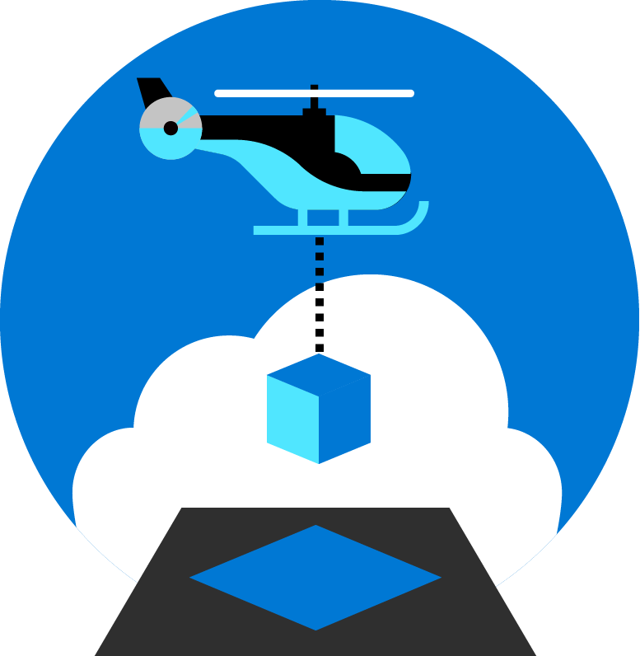
Azure landing zones help customers set up their Azure environment for scale, security, governance, networking, and identity.
Azure landing zones:
Enable migrations and net new apps
Consider all platform resources
Don't differentiate between IaaS or PaaS

Slide 8
How do you get started?
Azure Landing Zones
Foundation blueprint
Platform Development Velocity: how fast your cloud platform team can develop the required skills.
Iterative implementation
Migration blueprint
Terraform modules
Rich initial implementation
Enterprise-scale Landing Zones
Priority areas for this session
Notes:
Focus for this session is CAF Foundation blueprints and CAF Migration blueprints
Talking points
CAF Migration landing zone blueprint Deploys the basic foundation for migrating low risk assets.
CAF Foundation blueprint Adds the minimum tools need to begin developing a governance strategy.
CAF Enterprise-scale landing zone Deploys an enterprise-ready platform foundation with all the necessary shared services to support the full IT portfolio.
CAF Terraform modules Third-party path for multicloud operating models. This path can limit Azure-first operating

Slide 9
Azure Landing Zones Design Areas

Slide 10
Azure landing zones Design areas
Enterprise Enrollment
Business Continuity & Disaster Recovery
Identity
Governance Disciplines
Resource Organization
Deployment Options
Network Topology & Connectivity
Operations Baseline
Priority areas for this session
Notes:
Regardless of the deployment option, each of the following should be considered and decisions should be made for each design area. Those decisions will impact the platform foundation that each landing zone will depend on.
Talking points ---
Enterprise enrollment: IF you are making a commitment to use a specific amount of Azure, you'll want to consider how your EA enrollment is configured & ensure your Azure AD tenant is aligned.
Identity: Are you using your existing Azure AD tenant from Office 365 by applying RBAC? Or do you have deeper security requirements that require more considerations?
Resource organization: Get a jump on cloud governance by preparing for proper resource organization early. This includes things like naming, tagging, subscriptions, resource groups, and management groups. Good design now will make portfolio governance easier later
Network Topology & Connectivity: are the two must have considerations. Until you understand how things connect to in the cloud & how people gain access, you can't really use the cloud
Business continuity and disaster recovery - BCDR provides the foundation for reliability and rapid recovery. BCDR isn't really a design area, its a discipline under CAF Manage. i don't generally talk to it as a pillar, even though its on the design areas page. if anything just a brief mention of it during the Operations baseline talking point.
Governance disciplines: Begin including the governance disciplines in every landing zone to get an early start on governance, security baseline, and compliance policies.
Deployment options: Azure landing zones provide a variety of deployment options to fit your operating model
Operations Baseline: Get a jump start on operations management (CAF Manage) by preparing each landing zone for visibility, operational compliance, and protect/recover processes.

Slide 11
Network decision guide Evaluate each of the following concerns to identify potential services and features when modifying your blueprint
Starting from the CAF migrate landing zone blueprint
Require a virtual network?
No
Underlying platform networking capabilities may be sufficient for some PaaS only workloads
PaaS Only (Remove virtual network from blueprint)
Yes
Virtual Network (included in blueprint by default)
Yes
Express Route
Yes
Higher reliability and >1.25Gbps bandwidth?
No
VPN Gateway
On-premises connectivity?
Yes
Inspect outgoing traffic using on-premises or cloud device?
On-premises
Force tunnel to on-premises
Cloud
Force tunnel to Azure Firewall or 3rd party NVA
Need to connect virtual networks/subscriptions?
Yes
Centrally managed shared services?
Yes
Hub and Spoke / vWAN
No
VNet Peering
Azure Firewall or 3rd party NVA
Workloads available to untrusted networks or internet?
Yes
Azure Front Door
App Gateway
Traffic Manager
Yes
Deploy Azure Active Directory Domain Services
Yes
Require a managed Active Directory domain controller service?
No
Deploy custom IaaS DNS VM
Require custom DNS settings?
No
Azure DNS

Slide 12





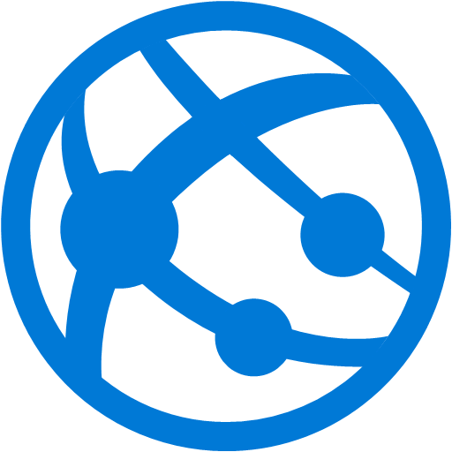
Azure Role-Based Access Control (RBAC)
1
Security Principal
Fine-grained access control to Azure “control plane”
Grant access by assigning Security Principal a Role at a Scope
Security Principal: User, group, or service principal
Role: Built-in or custom role
Scope: Subscription, resource group, or resource
Assignments are inherited down the resource hierarchy
User
Group
Service principal
Managed Identity
“Actions”: [
“*”
],
“NotActions”: [
“Auth/*/Delete”,
“Auth/*/Write,
“Auth/elevate…
Marketing group
Role assignment
Contributor
Pharma-sales resource group
2
Role definition
Scope
3
Owner
Contributor
Reader
…
Backup Operator
Security Reader
User Access Administrator
Virtual Machine Contributor
Management group
Subscription
Resource group
Built-in
Reader Support Tickets
Virtual Machine Operator
Learn more https://aka.ms/azureiam
Custom
Resource
Notes:
Using RBAC, you can segregate duties within your team and grant only the amount of access to users that they need to perform their jobs. Instead of giving everybody unrestricted permissions in your Azure subscription or resources, you can allow only certain actions at a particular scope.
<CLICK1>
Security principal
A security principal is an object that represents a user, group, service principal, or managed identity that is requesting access to Azure resources.
- Service principal - A security identity used by applications or services to access specific Azure resources. You can think of it as a user identity (username and password or certificate) for an application.
Managed identity - An identity in Azure Active Directory that is automatically managed by Azure. You typically use managed identities when developing cloud applications to manage the credentials for authenticating to Azure services.
<CLICK2>
Role definition
A role definition is a collection of permissions. It's sometimes just called a role. A role definition lists the operations that can be performed, such as read, write, and delete. Roles can be high-level, like owner, or specific, like virtual machine reader. You can create custom roles if none of the existing built-in roles don't meet the specific needs of your organization.
<CLICK3>
Scope
Scope is the boundary that the access applies to. When you assign a role, you can further limit the actions allowed by defining a scope. This is helpful if you want to make someone a Website Contributor, but only for one resource group.

Slide 13
Tagging Decision Guide
IT Aligned Tagging
Business Aligned Tagging
Primary design considerations:
Baseline operations requirements supplemented by additive business requirements
Baseline Naming Conventions
Resource naming is required for any deployment
A standardized Naming Scheme is the minimum “Tag”
Functional
Add tags that describe the function of the VM for easy identification
Example: Workload, Function in the workload (app, data, etc.), Environment (Dev, Staging, Prod, etc.)
Classification
Tags that classify the value of an asset can aid in decision making
Example: Data Classification (Public, Private, Confidential, etc.), Criticality, SLA
Accounting
Track costs associated with asset operations
Example: Department, Project, Region, etc.
Partnership
Align partners that count on this asset, outside of IT
Example: Owner, Owner Alias, Stakeholder, Power User, Executive
Purpose
Aligning an asset to a business function can be valuable in making investment decisions
Example: Business Process, Business Criticality, Revenue Impact

Slide 14


Resource Groups, Tags and RBAC
Finance/Business
TAGS
TAGS
Need to be able to break out costs by various dimensions such as Customer, Cost Center, Environment.
Create roles with appropriate permissions.
Always Tag!
Owner
Dept.
Environment
Application
(Cost Center)
Resources in an RG should be tagged as needed.
Best Practices on using Resource Tags: https://azure.microsoft.com/documentation/articles/resource-group-using-tags/
Custom RBAC Roles: https://azure.microsoft.com/documentation/articles/role-based-access-control-custom-roles/
Manage tag governance with Policy: https://docs.microsoft.com/azure/governance/policy/tutorials/govern-tags
Notes:
Resource in an RG should always be tagged as a best practice.

Slide 15
Do you need more?
To migrate you absolutely need:
RBAC
Network
Naming & Tagging
But you may need a mature landing zone configuration to address:
Governance
Security
Operations
Shared foundational utilities
Enterprise Enrollment
Business Continuity & Disaster Recovery
Identity
Governance Disciplines
Resource Organization
Deployment Options
Network Topology & Connectivity
Operations Baseline
Notes:
Placeholder to note that the customer needs to decide how much deeper to go when network, RBAC, Naming/tagging are done.

Slide 16
Factors that influence the right setup
Organize Azure to reflect your organization, not the other way!
Cost transparency:
Set up a cost structure that reflects the actual usage for departments and projects
Tagging and ownership
Allowed resource types (policy)
Roles and responsibility:
Who has access to what. Account owners and delegations (RBAC)
Minimal access level to carry out the task
Design for Partners and 3rd parties
Compliance and Security:
Allowed locations e.g. EU (policy)
Network and connectivity (Internet facing, or using the approved VNETS? Policy and NSG)
Continuous Monitoring and integration to existing ITSM (Azure Monitor)

Slide 17




How to organize your Azure Resources
Use the management hierarchies within the Azure platform
Implement well-thought-out naming conventions
Apply resource tagging
Management groups
Subscriptions
Resource groups
Resources

Slide 18

What is Resource Consistency?
The basic foundation of all governance practices. Achieving the right Governance starts with the correct resource organization.
Management Group
Management Groups To reflect security, operations and business/accounting hierarchies.
Subscription
Subscriptions To group similar resources into logical collections.
Resource Group
Resource Groups To further group applications or workloads into deployment and operations units.

Slide 19


Subscription | Design considerations
Develop the Subscription, Network, Storage, Availability and Administrative models together in order to have a cohesive approach.
Service (Process) Design Model
Organizational Unit Design Model
Azure Account
Azure Account
Development Subscription
Lab Subscription
QA Subscription
Production Subscription
HR Department
Accounting/ Finance Department
Marketing Department
Services Consumed
Services Consumed
Services Consumed
Services Consumed
Services Consumed
Services Consumed
Services Consumed
Azure Automation
Cloud Service
Azure Automation
Cloud Service
Azure Automation
Cloud Service
Azure Automation
Cloud Service
Azure Automation
Cloud Service
Azure Automation
Cloud Service
Azure Automation
Cloud Service
Operational Insights
Virtual machine
Operational Insights
Virtual machine
Operational Insights
Virtual machine
Operational Insights
Virtual machine
Operational Insights
Virtual machine
Operational Insights
Virtual machine
Operational Insights
Virtual machine
Traffic Manager
Document DB
Traffic Manager
Document DB
Traffic Manager
Document DB
Traffic Manager
Document DB
Traffic Manager
Document DB
Traffic Manager
Document DB
Traffic Manager
Document DB
Items to look at when designing the subscription model:
Business Requirements
Accountability
Audit/Compliance
Performance
Availability & Recoverability
Technical Requirements
Network Connectivity (shared or dedicated)
Active directory requirements, clustering, identity, management tools
Security Requirements
Who are the subscription administrators
Least privilege model
Scalability Requirements
Growth plans
Allocation of limited resources
Evolution over time (users, shared access, resource limits)

Slide 20
Single subscriptions vs. multiple | Considerations
Subscriptions have different quota limits for different resource types
At a certain level of usage you will need to create new subscriptions to scale out, so you need to have a strategy for doing so
A very crucial workflow that can slow down a lot of organizations
Some questions you’ll need to answer:
Who will be responsible for creating subscriptions?
What resources will be in a subscription by default?
Subscription A
Subscription B
Subscription C
…

Slide 21
Organize subscriptions
Ask yourself the following questions:
Are there any capacity / technical limitations?
Do we want to ensure separation of concerns? In example:
Separation of duties
Dev/Test Vs. Production
Different end customers
Different departments or business units
Different projects
What is the right naming convention to be used? i.e.: <Company> <Department (optional)> <Product Line (optional)> <Environment>
Use a dedicated subscription for shared infrastructure (i.e. Azure Active Directory, monitoring and patching tools…). You will be able to spread the cost of this mutualized infrastructure to app owners.
Notes:
https://docs.microsoft.com/en-us/azure/architecture/best-practices/resource-naming

Slide 22
Management Group best practices
Management Group
Define your hierarchy based on organization and environment type (prod, pre-prod, etc.)
The root MG is for global configuration
Be careful with MG level assignments as they will cascade through large chunks of your hierarchy
Try not to repeat yourself. Assign common policies and RBAC higher up in your hierarchy
Built-in RBAC roles for MGs (MG contributor, MG reader)
Need subscription owner access to move to another MG
Corporate IT
Production
Development
QA
Subscription
Mission Critical
Protected Data
Other Production
Non-Production
Staging
Resource Group
App1
App4
App6
App1
App1
App2
App5
App4
App3
App5

Slide 23
Governance MVP Considerations
Management Group
Resource Organization
Build only what you need, add as the requirements are needed.
Management Group Hierarchy
Business Unit
Geography
Environment
Subscription
Per Application Category
Pre-production
Dev environments
Production
Resource Groups
Per Application
Business Unit
Geography
Policies
Environment (Production & Non-Production)
Environment (Non-Production & Production)
Subscription
Mission Critical
Protected Data
Other Production
Non-Production
Non-Production
Mission Critical
Protected Data
Other Production
Resource Group
App1
App4
App6
App1
App10
App7
App8
App11
App2
App5
App4
App9
App12
App3
App5
App10

Slide 24
Azure Blueprints

Slide 25


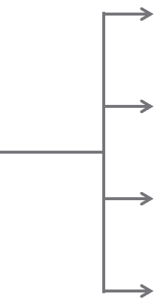

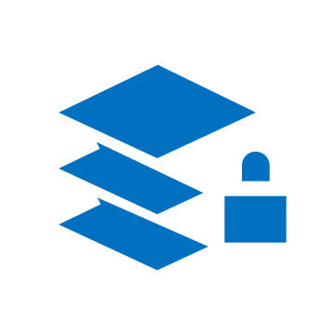
Azure Blueprints
Deploy and update cloud environments in a repeatable manner using composable artifacts.
Role-based access controls
Management groups
Policy definitions
Subscription A
ARM templates
Azure Blueprints
Subscription B
Resource groups
Subscription C
…
compose
manage
scale

Slide 26
Ready | First Landing Zone
More
Policy
C
ISO 27001 – Shared Services
ISO 27001 – ASE/SQL Workload
NIST SP 800-53 Rev 4
UK Official
Landing zone is the environment that is provisioned to host workloads being migrated from an on-premises environment into Azure.
The Cloud Adoption Framework migrate landing zone blueprint creates a landing zone which can be updated to meet your specific needs.
Primitives
B
Network
D
Partner blueprints
Identity
A
Compliance requirements
Data
CAF Migrate Landing Zone Blueprint
Storage
Compute
Less
Less
Architectural complexity
More

Slide 27
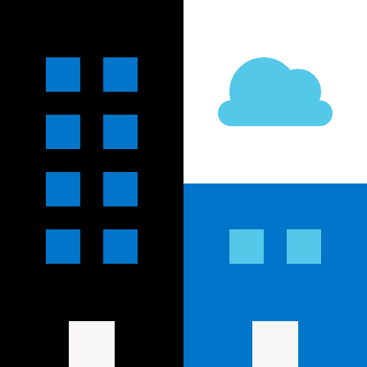
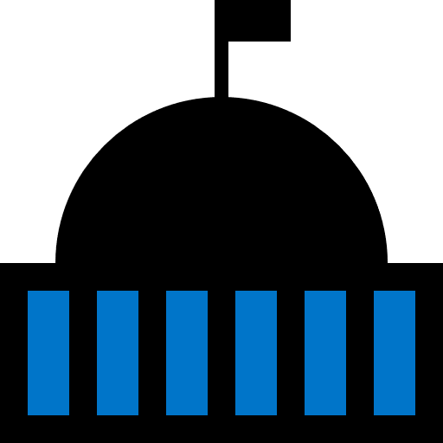
Ready | Expand the landing zone blueprint
The considerations for implementing a landing zone fall into three categories.
Hosting
Decisions need to be made around compute, storage, networking, databases to help create hosting options in the landing zone blueprint.
Azure fundamentals
These are the foundational building blocks for organizing resources in the cloud environment.
Governance considerations
Applying governance principles on each landing zone.

Slide 28
Ready | Recommended Practices
Leverage best practices in Cloud Adoption Framework to help your teams establish and prepare the Azure environment. These include guidance in the areas of:
Azure fundamentals
Networking
Identity and Access Control
Storage
Databases
Cost Management

Slide 29


Deploy the policies using Azure Blueprints to create Governance MVP
Cloud Adoption Framework Foundation blueprint deploys recommended infrastructure resources to put in place the foundation controls necessary to manage the cloud estate.
This environment is composed of:
An Azure Key Vault
Deploy Log Analytics
Deploy Azure Security Center (standard version)
The blueprint also defines and deploys Azure Policies, for
Tagging (CostCenter) applied to resources groups
Append resources in resource group with the CostCenter Tag
Allowed Azure Region for Resources and Resource Groups
Allowed Storage Account SKUs (choose while deploying)
Allowed Azure VM SKUs (choose while deploying)
Require Network Watch to be deployed
Require Azure Storage Account Secure transfer Encryption
Deny resource types (choose while deploying)
Initiatives
Enable Monitoring in Azure Security Center (89 Policies)
Azure Subscription
Resource Group
Storage Accounts
Log Analytics
Security Center
Key Vault
Azure Active Directory
Azure Policy
Core infrastructure services

Slide 30
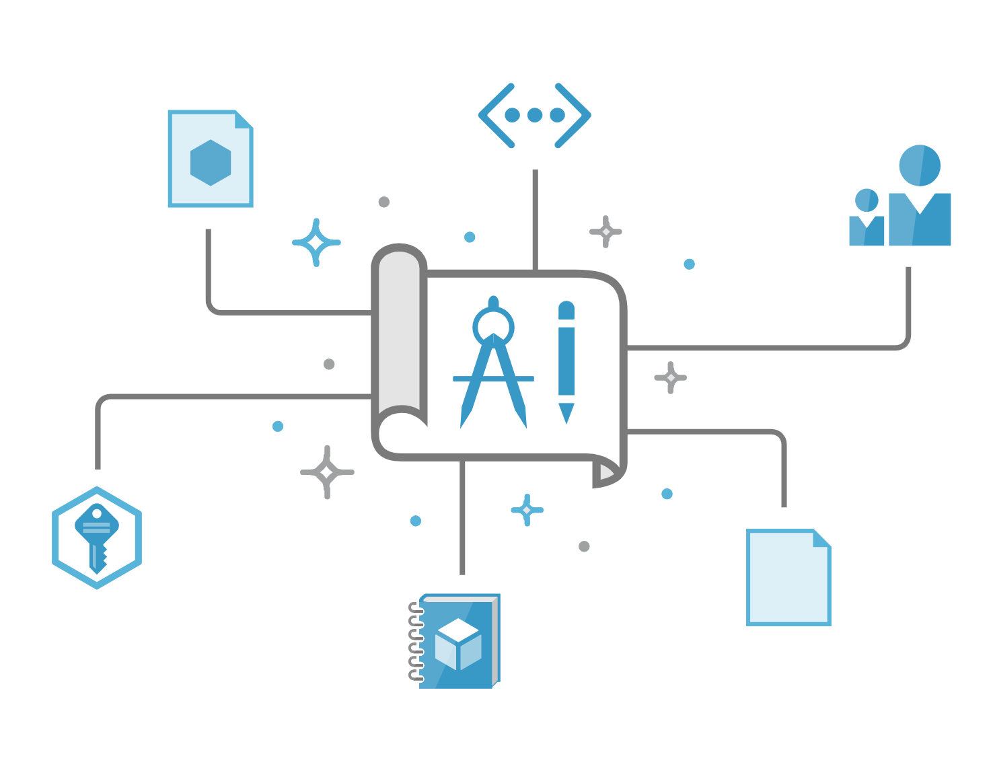
Demo Azure Blueprint CAF Foundation blueprint
Notes:
From the CAF Foundation blueprint, select ‘Deploy the blueprint sample’ and follow the instructions for ‘Create blueprint from sample’ and ‘Publish the sample copy’.
*For complete details in facilitating the demo, please refer to the train-the trainer video for this session at https://assetsprod.microsoft.com/mpn/en-us/session-5-introduction-to-the-landing-zone.pptx.

Slide 31
Azure Policy

Slide 32
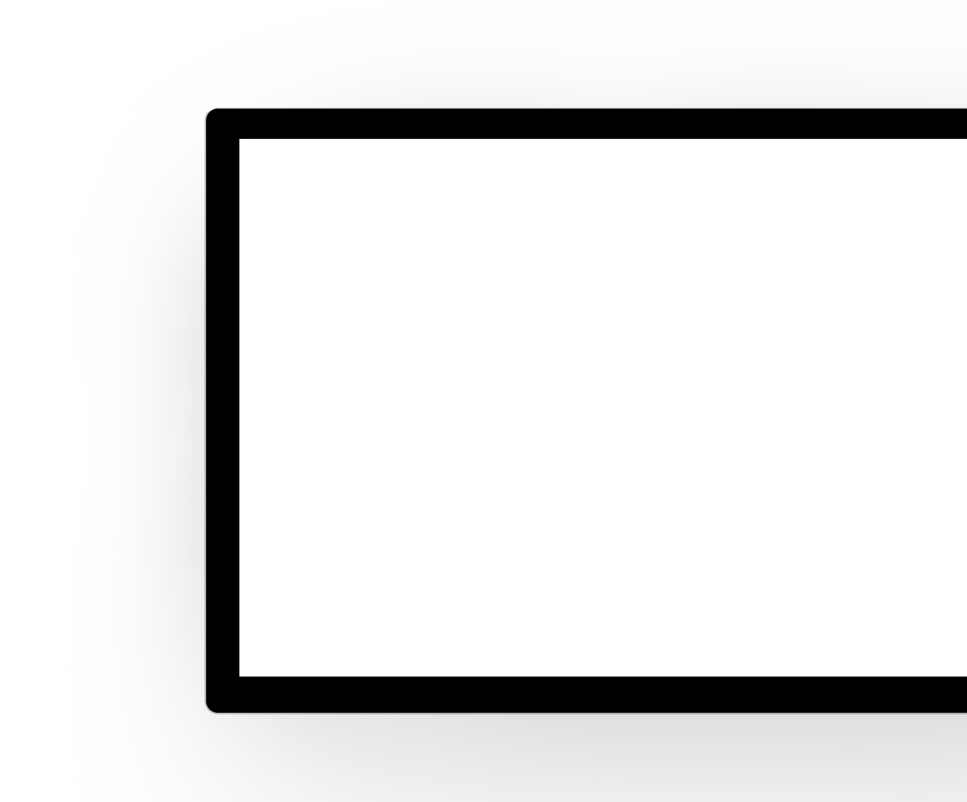
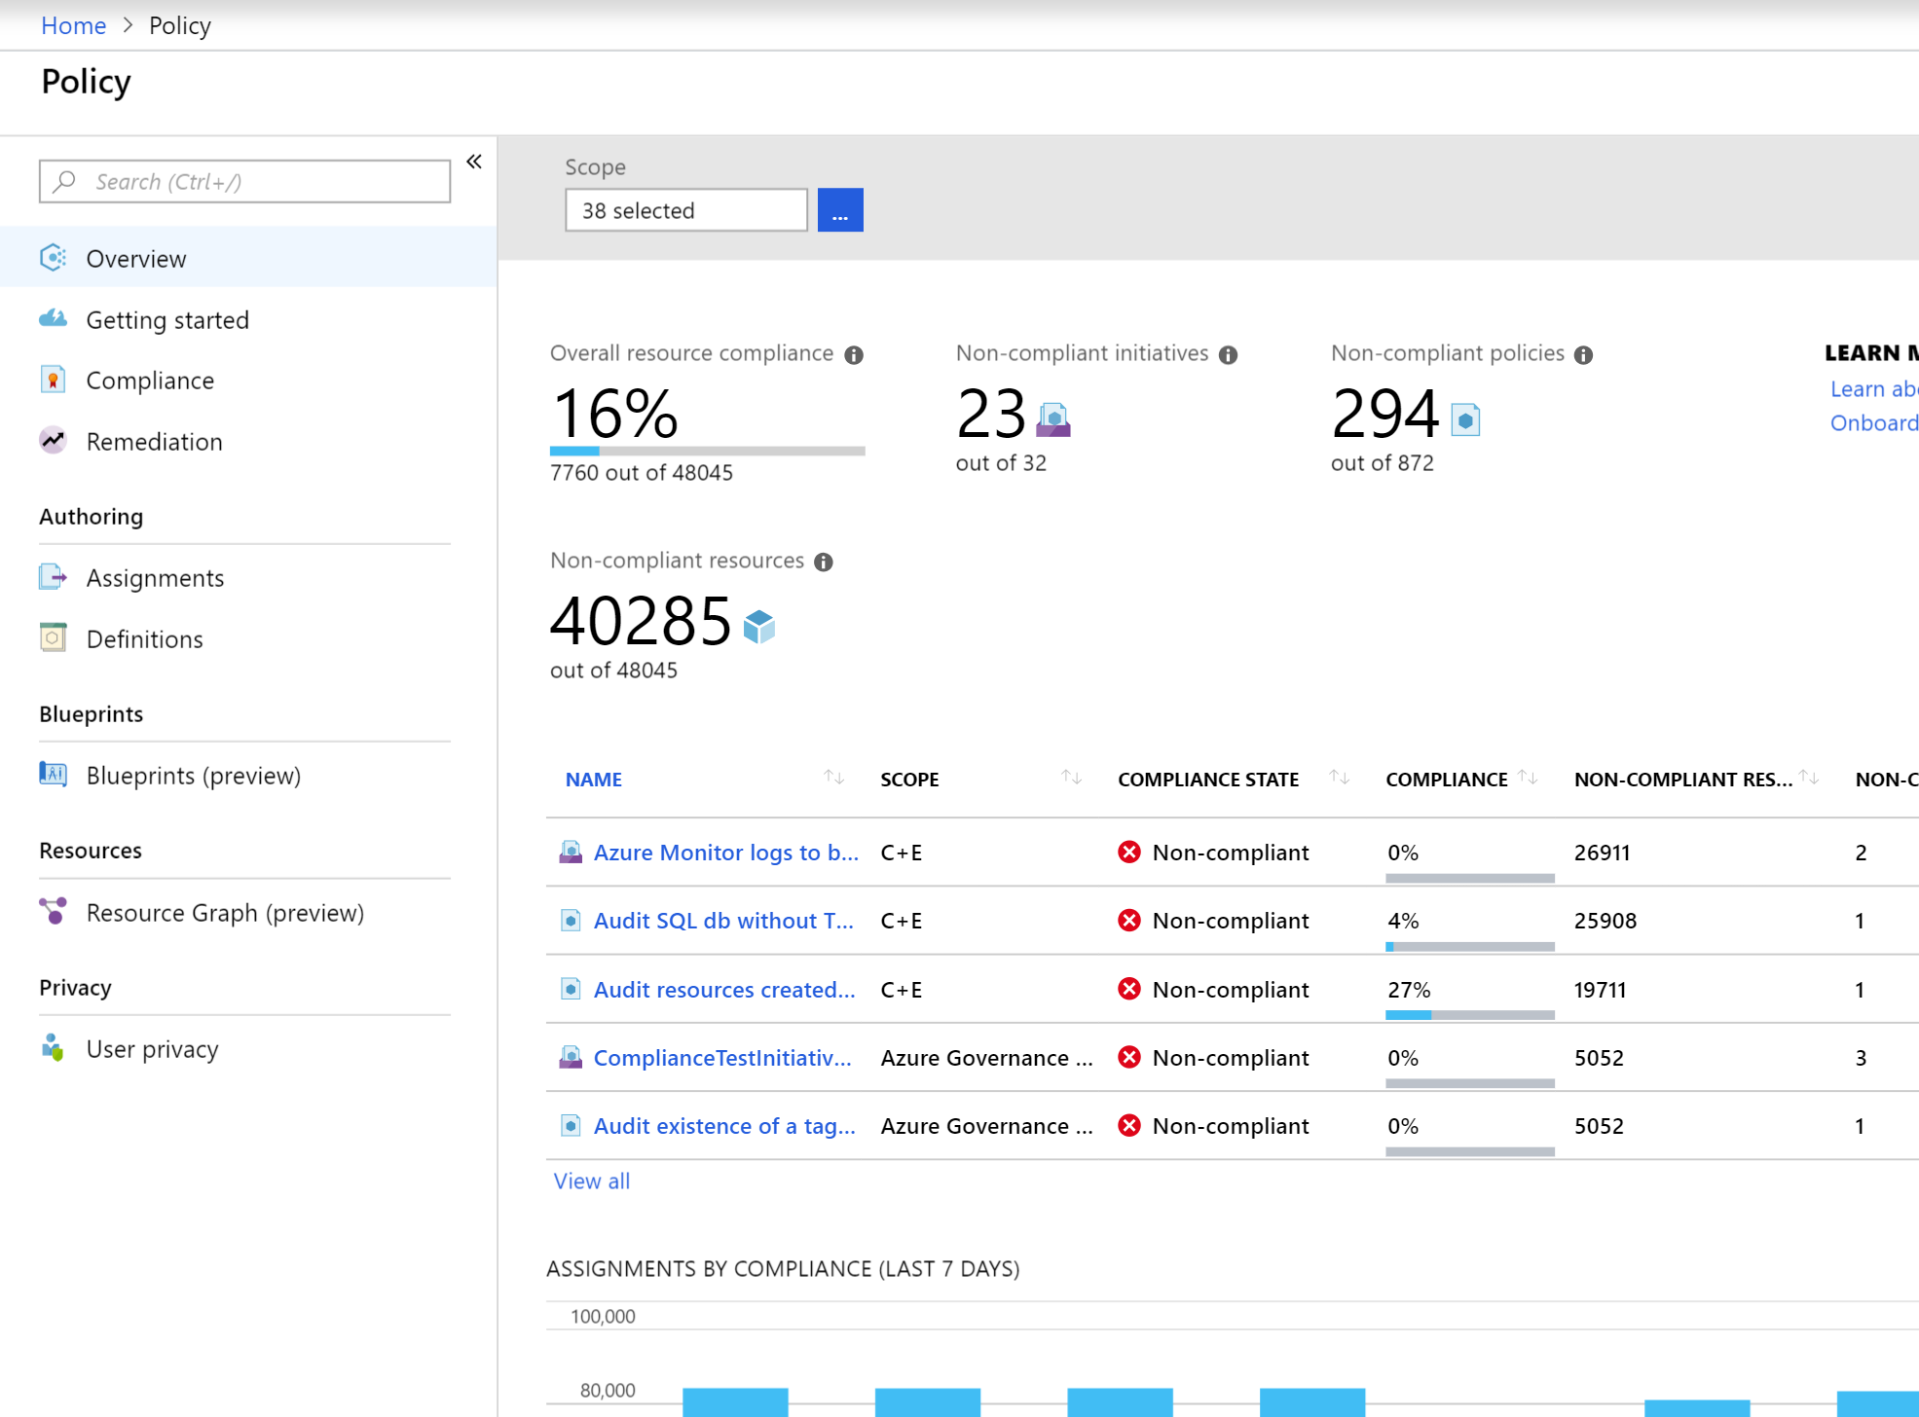
Policy | Key info
Real time policy enforcement and at-scale compliance assessment
Policy evaluates all Azure resources & in-guest VM
Policy generate compliance events that can be used for alerting
Aggregated and raw compliance data are available through API, PowerShell & CLI
Can be used to automatically remediate problems in your environment

Slide 33
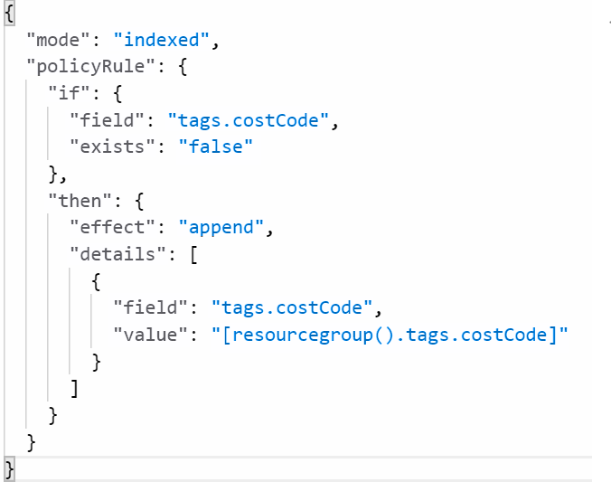
Policy | Scenarios
Restrict location or resource type (built-in)
Inherit tags from Resource Group (see right )
Block ‘open to any’ NSG rule creation (Github)
Enable diagnostic logs at-scale (MVP blog)
Security (built-in from Azure Security Center & In-Guest)

Slide 34
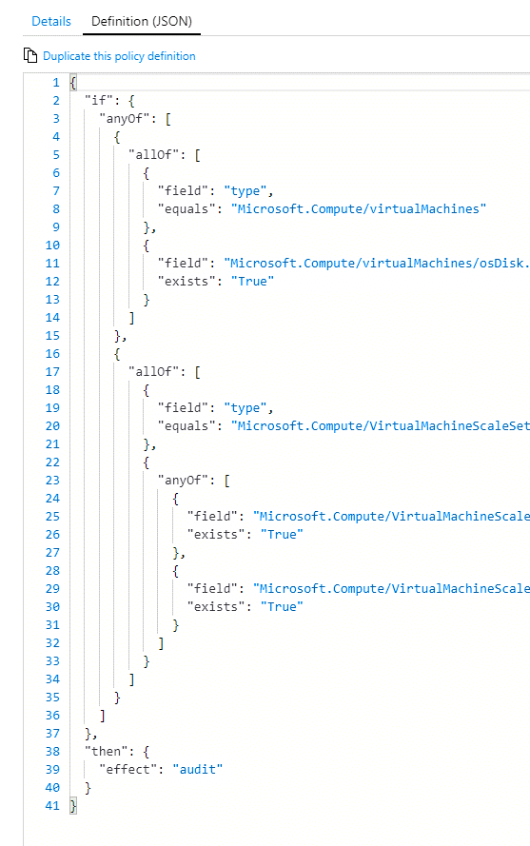
Policy | Best practices
Start with Audit Policies, which is a safe way of understanding what a policy will do without affecting user activity
Used staged rollouts for Deny policies to understand impact
Rollout remediation in stages

Slide 35
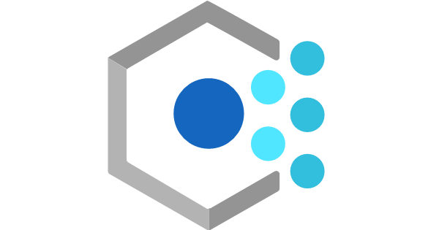
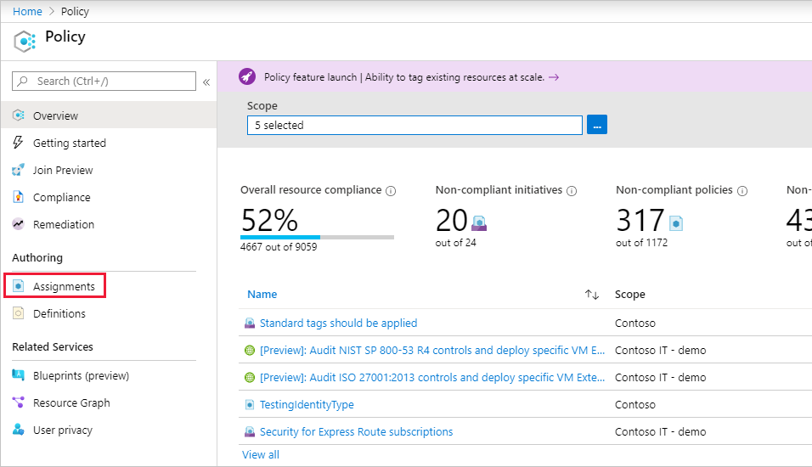
Demo Azure Policy CAF Foundation blueprint
Notes:
Follow the instructions for ‘Assign the sample copy’. Below ‘Assign the sample copy’, there is a section called ‘ Artifact parameters table’ – you can choose any of the four policy assignments in the table to showcase. Note this is part of the same demo for blueprints.
*For complete details in facilitating the demo, please refer to the train-the trainer video for this session at https://assetsprod.microsoft.com/mpn/en-us/session-5-introduction-to-the-landing-zone.pptx.

Slide 36
Next steps

Slide 37
Next steps
Consider building the landing zones to enable your workloads deployment to Azure
Leverage Azure Blueprints for migration or foundational scenarios
Learn more about design areas considered by all Azure landing zones
Configure your environment using landing zone implementation options

Slide 38
Thank you
Notes:
Thank You

